Slide 1

Sant Longowal Institute of Engineering & Technology, Longowal – 148106
District – Sangrur, Punjab
Presentation
On
Introduction to Machine Learning
&
Its algorithms
Submitted by Under the Guidance of
Smriti Rani Birmohan Singh
GCS 1830033

Slide 2
What is Machine Learning
Machine Learning is an application of Artificial Intelligence (AI) that provides systems the ability to automatically learn and improve from experience without being explicitly programmed.
In Machine Learning ,algorithms are ‘trained’ to find patterns and features in massive amounts of data in order to make decisions and predictions based on new data. The better the algorithm , the more accurate the decisions and predictions will become as it processes more data.
Today, examples of machine learning are all around us.
Digital assistants search the web and play music in response to out voice commands.
Website recommends products , songs and movies based on what we bought , watched or listened to before.
Robots vacuum our floors while we do something better with our time.
Spam detectors stops unwanted emails from reaching our inboxes. Medical image analysis systems help doctors spot tumours they might have missed.
The other applications of machine learning includes Health Care , Sentiment analysis , Fraud Detection , E-Commerce.
As big data keeps getting bigger, as computing becomes more powerful and affordable ,and as data scientist keep developing more capable algorithms, machine learning will drive greater and greater efficiency in our personal and work lives.

Slide 3
Life without Machine Learning
Data is the lifeblood of all business. Machine learning can be the key to unlocking the value of corporate data and enacting decisions that keep a company ahead of the competition.
If we imagine a world without Machine Learning , the world’s best search engines like Google , Youtube , Amazon , Facebook etc. and all the services which we are currently using such as play store , Gmail etc. to make our work a little more easier won’t be the best.
We won’t be having the applications like:
Traffic alerts which includes Google maps to predict the upcoming traffic and adjust your route according to it .
Transportation and Commuting which includes Uber which automatically detects your location and provides options to either go home or office or any other frequent place based on your history and patterns.
Social Media which includes Facebook having automatic friend tagging suggestions , face detection and image recognition to automatically find the face of the person which matches it’s database and hence suggests us to tag that person based on Deep Face.
Products Recommendations in shopping websites like amazon or recommendation of videos on youtube because of google tracking or search history and recommending ads based on our search history.
Virtual Personal Assistants like Speech Recognition , Speech to Text Conversion , Natural language processing and text to speech conversion in siri , Alexa , Google , Cortana. The personal assistant searches for information or recalls our related queries to collect information.
Self Driving Cars which collects data on its surroundings from cameras and other sensors , interpret it , and decide what actions to take.as they learn how to perform these tasks as good as or even better than humans.

Slide 4
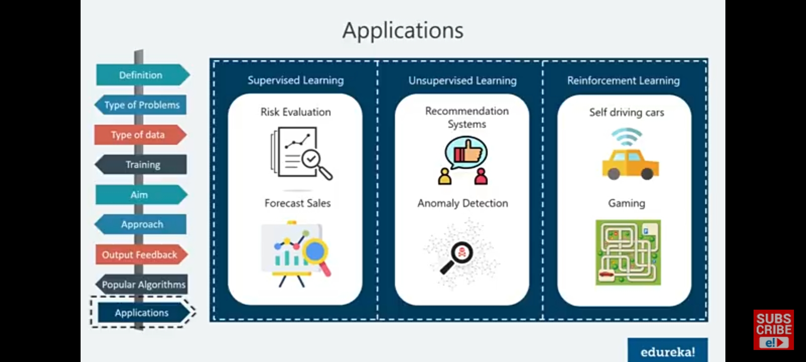
Types of Machine Learning
Supervised Learning – The machine learns from the training data that is labelled , gives direct feedback and can predict the output.
Unsupervised Learning – The machine learns from non-labelled training data , doesn’t provide feedback and finds the hidden structure in data.
Reinforcement Learning The machine learns from its behaviour based on feedback from the environment. This behaviour can be learnt once and for all, or keep on adapting as time goes by.

Slide 5
Supervised Learning
Supervised machine learning trains itself on a labelled data set . That is , the data is labelled with information that the machine learning model is being built to determine and that may even be classified in ways the model is supposed to classify data.
For Example : A computer vision model designed to identify purebred German shepherd dogs might be trained on a data set of various labelled dog images.
Supervised machine learning requires less training data than other machine learning methods and makes training easier because the results of the model can be compared to actual labelled results.
But, properly labelled data is expensive to prepare , and there is the danger of overfitting , or creating a model so closely tied and baised to the training data that is doesn’t handle variations in new data accurately.
Algorithms used for Supervised learning are Linear Regression , Logistic Regression , K Nearest Neighbour , random Forest.

Slide 6
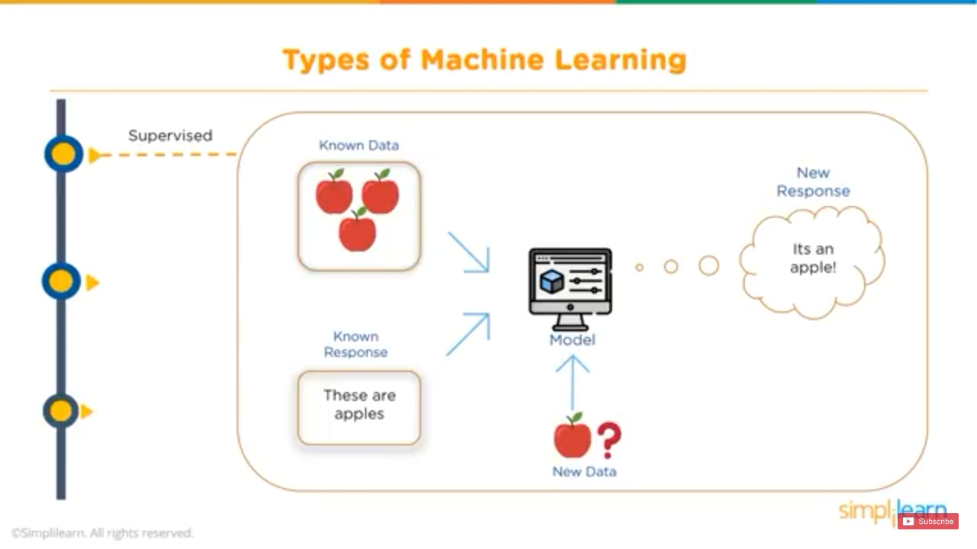
Supervised learning

Slide 7
Unsupervised Learning
Unsupervised machine learning ingests lots and lots of unlabelled data and uses algorithms to extract meaningful features needed to label ,sort , and classify the data in real time , without human intervention.
It is less about automating decisions and predictions , and more about identifying patterns and relationships in data that humans would miss.
Take Spam detection for example: People generate more emails than a team of data scientists could ever hope to label or classify in their lifetimes.
An Unsupervised Learning can analyse huge volumes of emails and uncover the features and patterns that indicate spam and keep getting better at flagging spam over time.
Algorithms used for Unsupervised learning are K-Means , Apriori , C-Means.

Slide 8
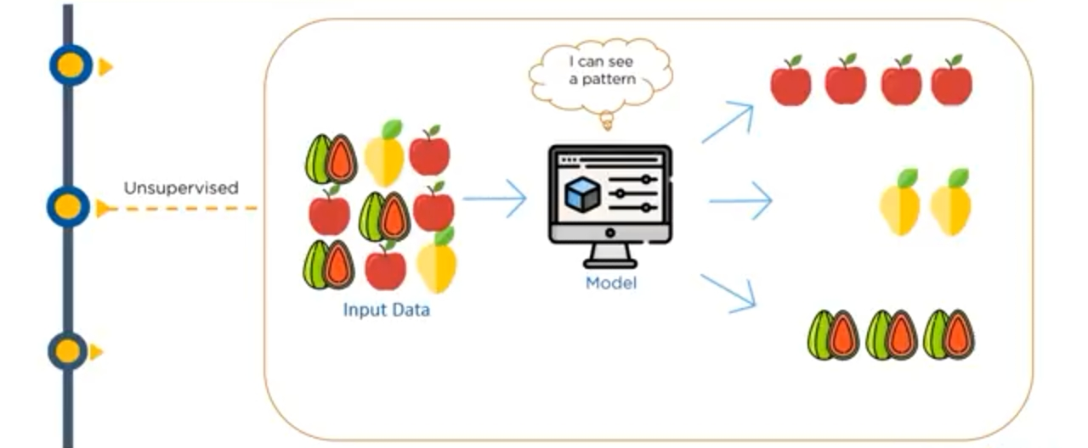
Unsupervised Learning

Slide 9
Reinforcement Learning
Reinforcement machine learning is a behavioural machine learning model that is similar to supervised learning , but the algorithm isn’t trained using sample data.
This model learns as it goes by using trial and error. A sequence of successful outcomes will be reinforced to develop the best recommendation or policy for a given problem.
Basically it is the training of machine learning models to make a sequence of decisions . The Agent leans to achieve a goal in an uncertain , potentially complex environment.
To get machine to do what the programmer wants , the artificial intelligence gets either rewards or penalties for the actions it performs . Its goal is to maximize the total reward.
Algorithms used for Reinforcement learning are Q-Learning , SARSA.

Slide 10
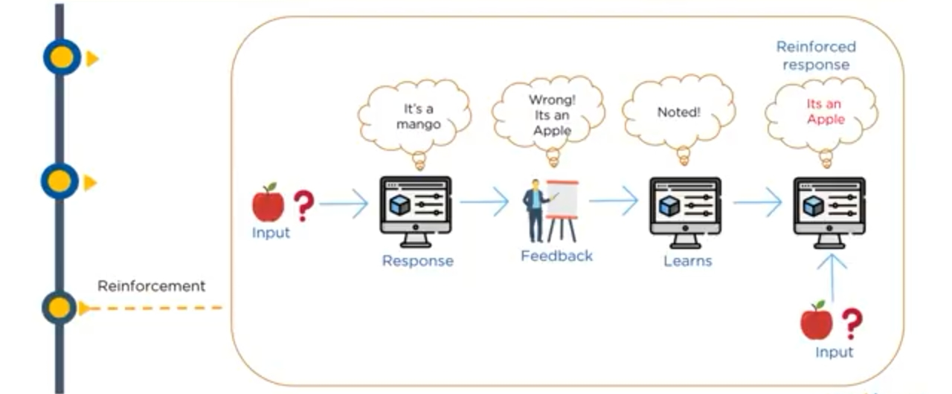
Reinforcement Learning

Slide 11
Semi-Supervised Learning
Semi-Supervised learning offers a happy medium between supervised and unsupervised learning.
Although not formally defined as a ‘fourth’ element of machine learning, it combines aspects of the former two into a method of its own.
During training , it uses a smaller labelled data set to guide classification and feature extraction from a larger , unlabelled data set.
It can solve the problem of having not enough labelled data or not being able to afford to label enough data to train a supervised learning algorithm.
The goal of semi supervised model is to classify some of the unlabelled data using the labelled information set.
Some applications are: Internet content classification – There are millions and millions of webpages . It is practically impossible to label all the web pages , if you need to . Semi supervised machine learning helps here to classify the webpages.
Audio/video analysis-We have an overwhelming amount of audio and video files all over. Labelling them is a massive task , if not unfeasible . Semi supervised learning comes handy in audio/video analysis.
One way to do semi-supervised learning is to combine clustering and classification algorithms . Clustering algorithms are unsupervised machine learning techniques that group data together based on their similarities . The clustering model helps us find the most relevant samples in our data set.

Slide 12
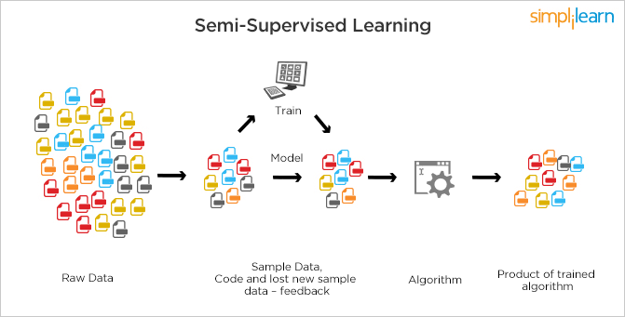
Semi-supervised Learning

Slide 13
Classification
Classification is type of supervised machine learning algorithm. It is used when the output is categorical like ‘yes’ or ‘no’.
For any given input, the classification algorithm helps in the prediction of the class of the output variable. When the output variable contains discrete values , it is classification problem.
There can be multiple types of classifications like binary classification , multi-class classification . It depends upon he number of classes in the output variable.
Algorithms which comes under Classification are:
Logistic regression
Decision Trees
Naive Bayes
Random Forest
Support vector machine
KNN.

Slide 14
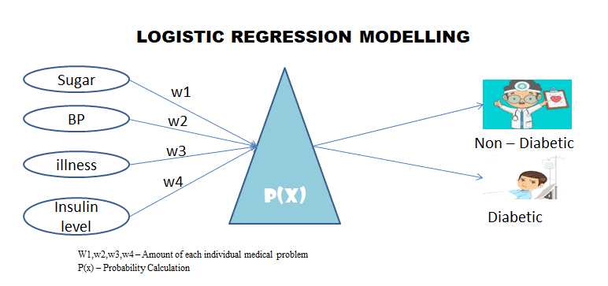
Logistic Regression
It is one of the linear models which can be used for Classification.
It uses the sigmoid function to calculate the probability of certain event occurring.
It is an ideal method for the classification of binary variables.

Slide 15
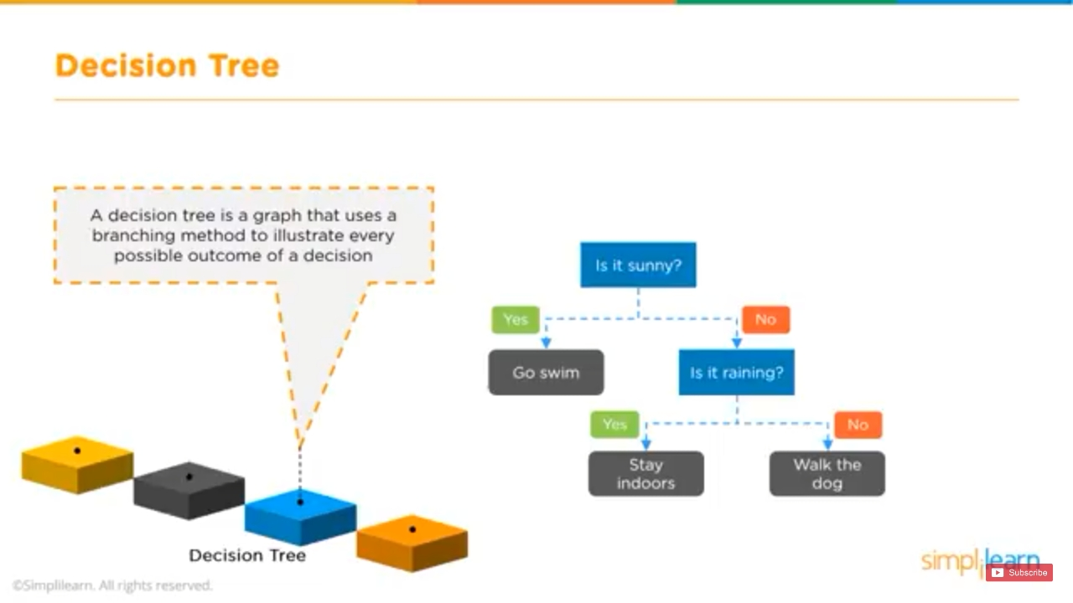
Decision Trees
It is non-linear model that overcomes few of the drawbacks of linear algorithms like Logistic regression.
It builds the classification model in the form of a tree structure that includes nodes and leaves.
This algorithm involves multiple if-else statements which help in breaking down the structure into smaller structures and eventually providing the final outcome.
It can be used for Regression as well as Classification problems.

Slide 16
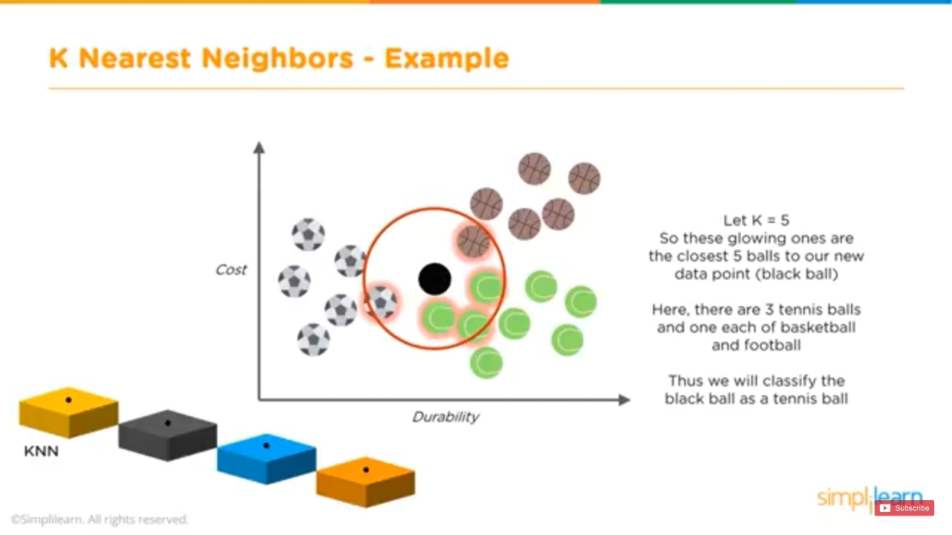
K-Nearest Neighbours(KNN)
It uses distance metrics like Euclidean distance, Manhattan distance , etc. to calculate the distance of one data point from every other data point.
To classify the output, it takes a majority vote from k nearest neighbours of each data point.

Slide 17
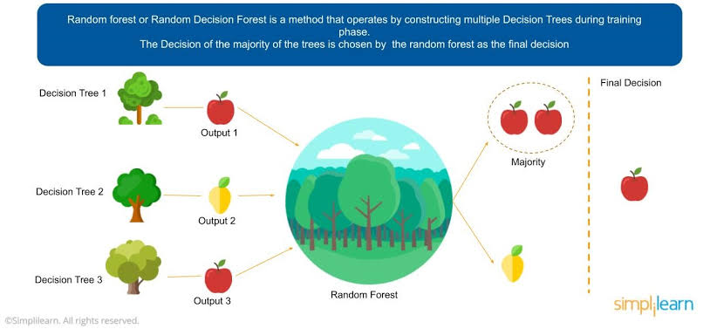
Random Forest
It is an ensemble learning method that involves multiple decision trees to predict the outcome of the target variable. Each decision tree provides its own outcome.
In the case of the classification problem , It takes the majority votes of these multiple decision trees to classify the final outcome.
In the case of the regression problem , it takes the average of the values predicted by the decision trees.

Slide 18
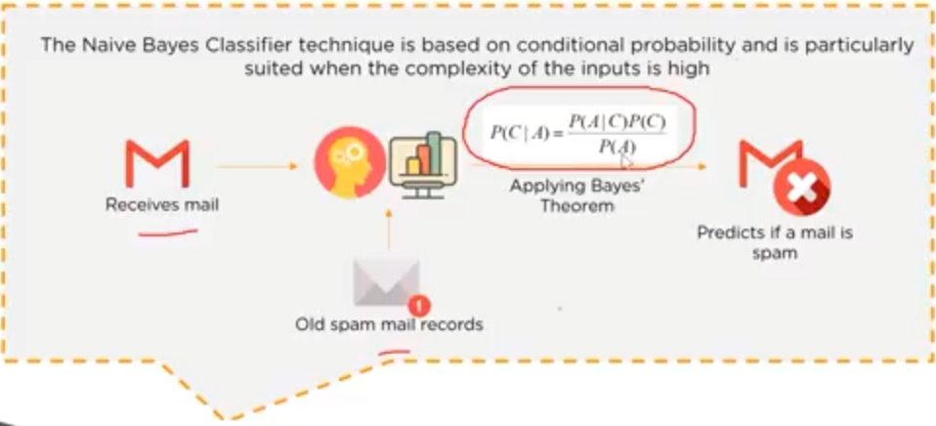
Naïve Bayes
It is an algorithm that is based upon Bayes’ theorem.
It assumes that any particular feature is independent of the inclusion of other features i.e. they are not correlated to one another.
It generally doesn’t work well with complex data due to this assumption as in most of the data sets , there exists some kind of relationship between the features.

Slide 19

Support Vector Machine
It represents the data points in multi-dimensional space.
These data points are then segregated into classes with the help of hyperplanes.
It plots an n-dimensional space for the n number of features in the dataset and then tries to create the hyperplanes such that it divided the data points with maximum margin.

Slide 20
Clustering
It is a type of unsupervised machine learning algorithm. It is used when the data needs to be organized to find patterns in the case of ‘product recommendation’.
Clustering is used to group data points having similar characteristics as clusters. Ideally, the data points in the same cluster should exhibit similar properties and the points in different clusters should be as dissimilar as possible.
Clustering is divided into two groups – hard clustering and soft clustering.
In Hard clustering , the data point is assigned to one of the clusters only whereas
In Soft clustering , it provides a probability likelihood of a data point to be in each of the clusters.
Algorithms which comes under Clustering are :
K Means
Hierarchical clustering.

Slide 21
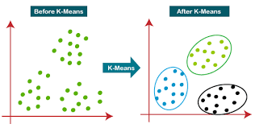
K-Means Clustering
It initializes a predefined number of k clusters and uses distance metrics to calculate the distance of each data point from the centroid of each cluster.
It assigns the data points into one of the k clusters based on its distance.

Slide 22
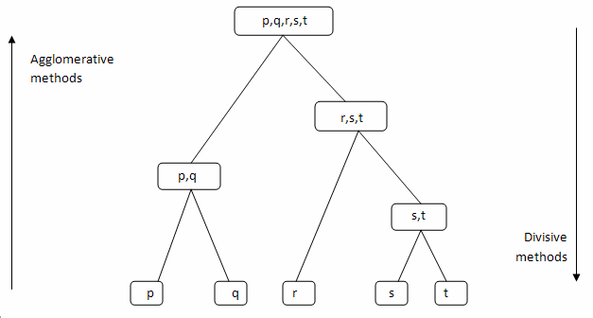
Agglomerative Hierarchical Clustering(Bottom-Up Approach)
It considers each data point as a cluster and merges these data points on the basis of distance metric and the criterion which is used for linking these clusters.

Slide 23
Divisive Hierarchical Clustering(Top-Down Approach)
It initializes with all the data points as one cluster and splits these data points on the basis of distance metric and the criterion.
Agglomerative and Divisive clustering can be represented as a dendrogram and the number of clusters to be selected by referring to the same.

Slide 24
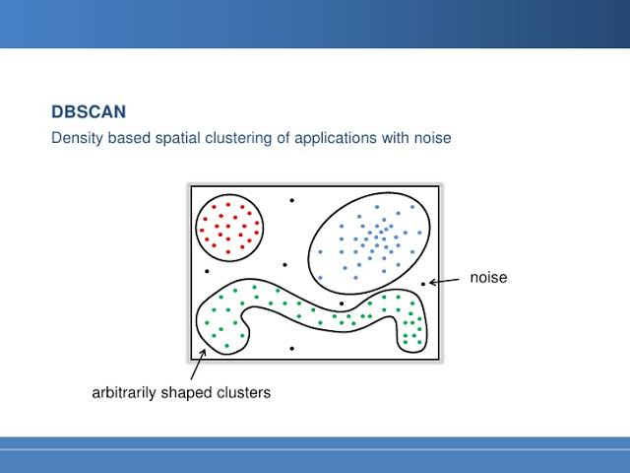
DBSCAN(Density-based spatial clustering of Applications with Noise)
It is a density based clustering method.
Algorithms like K-Means work well with clusters that are fairly separated and create clusters that are spherical in shape.
DBSCAN is used when the data is in arbitrary shape it is also less sensitive to the outliers.
It groups the data points that have many neighbouring data points within a certain radius.

Slide 25
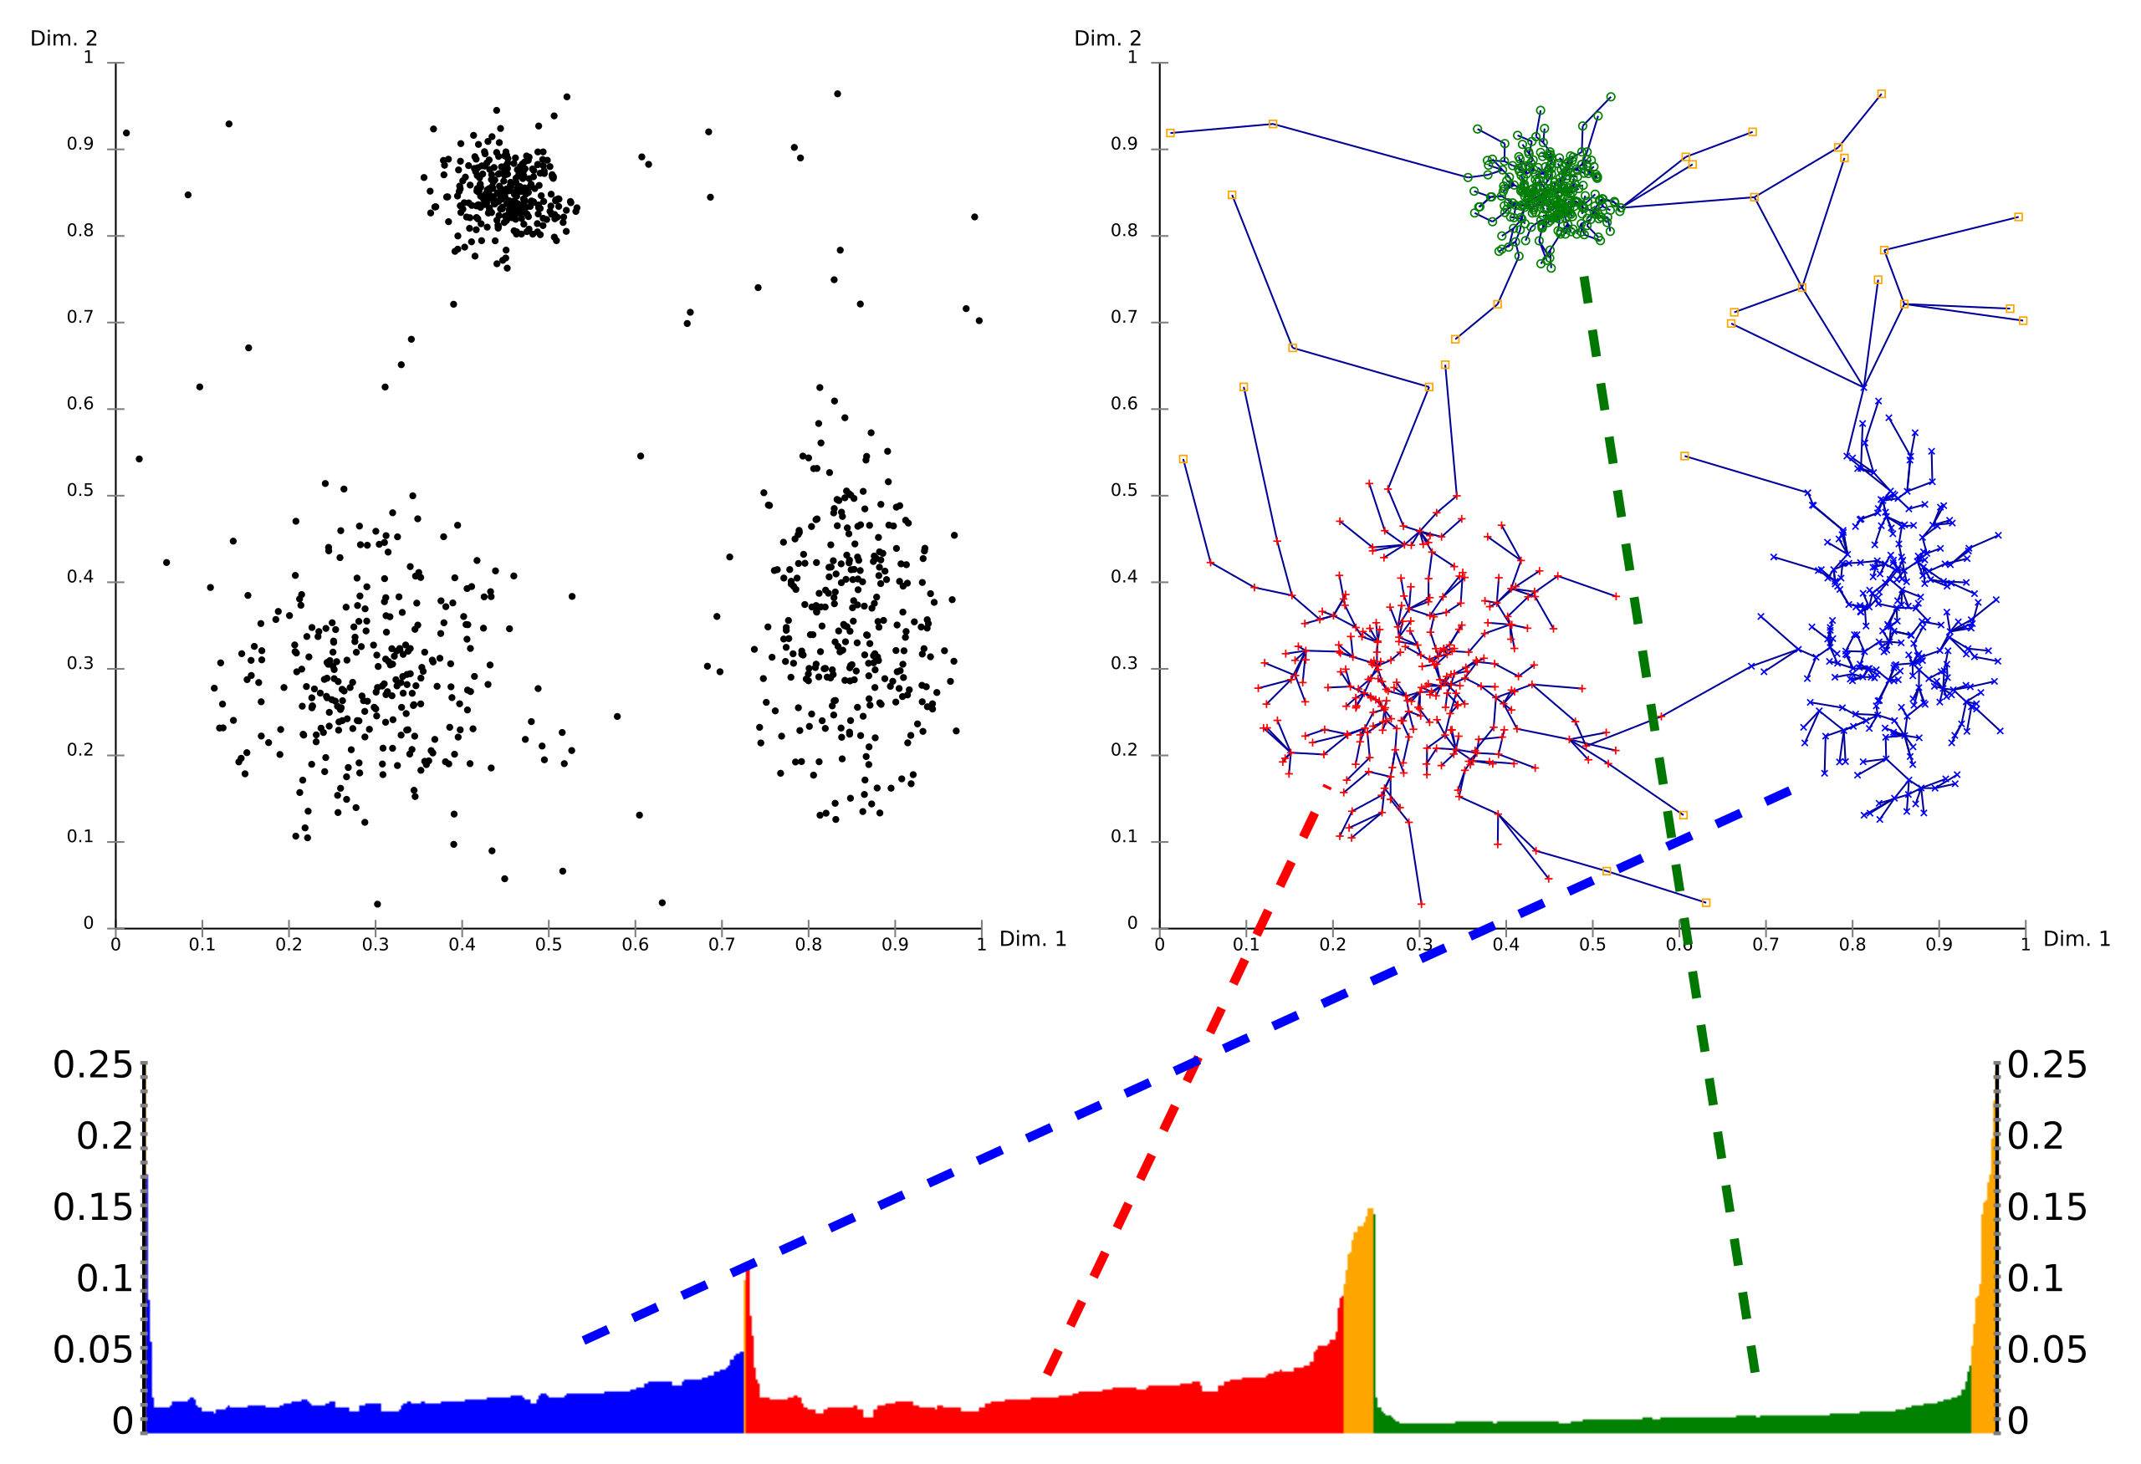
OPTICS(Ordering points to Identify Clustering structure)
It is another type of density-based clustering method and is similar in process to DBSCAN except that it considers a few more parameters. But , it is more computationally complex than DBSCAN.
Also , it doesn’t separate the data points into clusters , but it creates a reachability plot which can help in the interpretation of creating clusters.

Slide 26
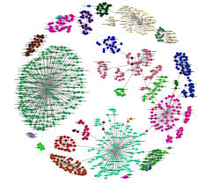
BIRCH(Balanced Iterative Reducing and clustering using Hierarchies)
It creates clusters by generating a summary of the data.
It works well with huge data sets as it summarises the data and then uses the same to create clusters. However , it can only deal with numeric attributes that can be represented in space.

Slide 27
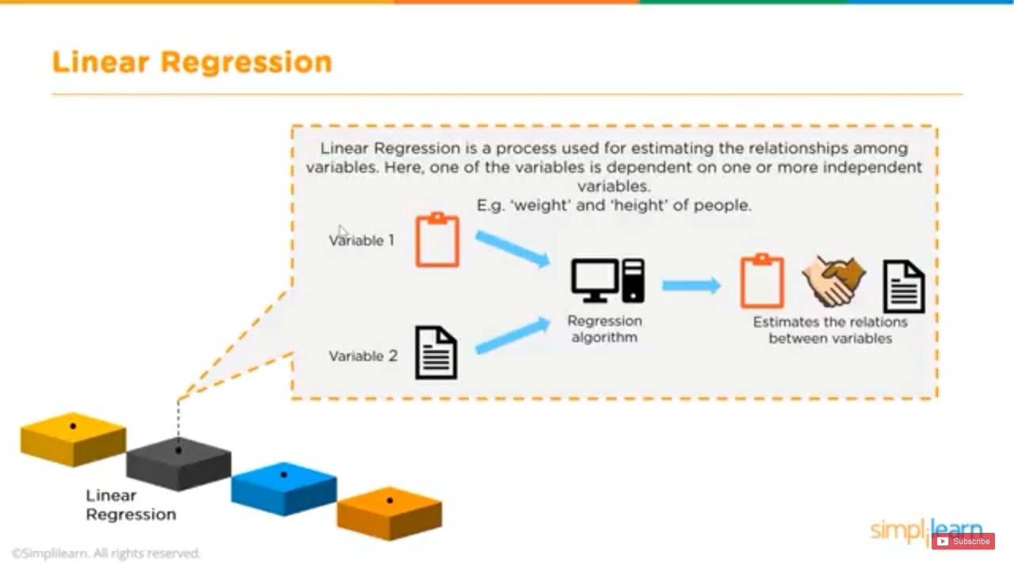
Regression
It is also a type of supervised learning algorithm. It is used when a value needs to be predicted like the ‘stock prices’.
When the output variable is continous , then it is a regression problem.
Algorithms which comes under Regression is: Linear Regression.

Slide 28
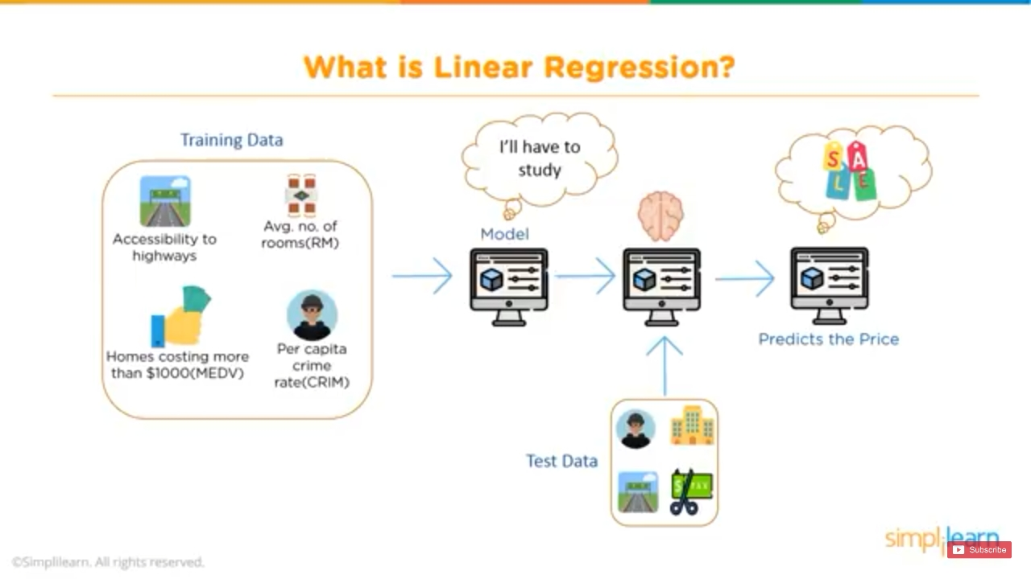
Linear Regression
Linear regression is a process used for estimating the relationships among variables . Here ,one of the variables is dependent on one or more independent variables.
Eg : Weight and Height of people.
Linear regression quantifies the relationship between one or more predictor variable(s) and an outcome variable . For example : it can be used to quantify the relative impacts of age , gender , and diet(the predictor variables) on height(the outcome variable).

Slide 29


